Slide 1

Operating systems
Lecture # 05

Slide 2
Lecture Overview
Thread / Multi Threading Concepts
Difference between Process and Threads
Multicore Programming
User and Kernal Level Threads
Multithreading Models
Thread application
Threading Issues

Slide 3
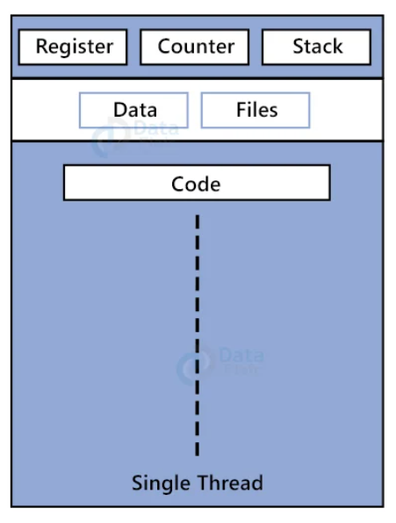
Thread concepts
A thread is a basic unit of CPU utilization.
It comprises a thread ID, a program counter (PC), a register set, and a stack.
It shares with other threads belonging to the same process its code section, data section, and other operating-system resources, such as open files and signals.

Slide 4
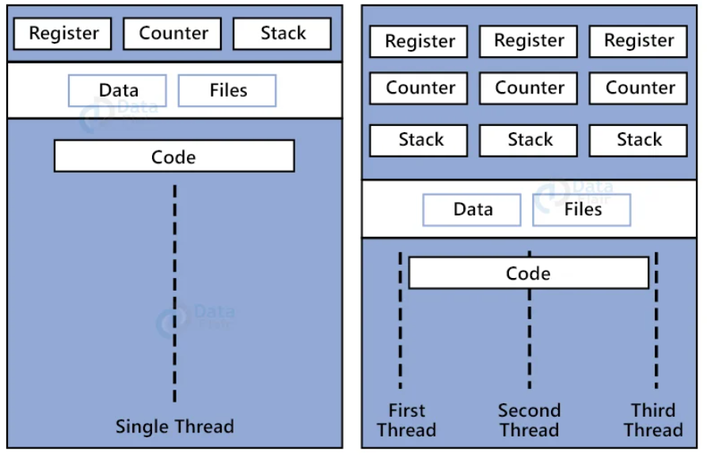
A traditional process has a single thread of control. If a process has multiple threads of control, it can perform more than one task at a time.

Slide 5
benefits OF MULTITHREADED PROGRAMMIG
1. Responsiveness | A multithreaded program remains responsive even if part of it is blocked or performing a lengthy operation
2. Resource Sharing | The same process share code, data, and files, which makes communication between them easier and more efficient compared to separate processes.
3. Economy | Requires fewer resources than creating and managing processes, as threads share the same address space.
4. Scalability (Better Utilization of Multiprocessors) | Threads can be distributed across multiple CPUs, allowing true parallelism and better performance on multicore systems.

Slide 6
 | Process VS | Thread
 | System calls involved in Process. | System calls does not involve in Process.
 | Each process has its own address space. | All threads of a process share the same address space.
 | Processes must use Inter-Process Communication (IPC) (e.g., pipes, sockets, shared memory). | Threads can communicate directly since they share memory.
 | OS treats different processes differently. | All user level threads treated as single task for OS.
 | Processes are independent; failure of one does not affect others. | Threads are interdependent; failure of one thread can crash the whole process.
 | Context Switching is slower. | Context Switching is faster.
 | Running two separate applications like Chrome and Word. | Multiple tabs or background tasks inside Chrome.

Slide 7
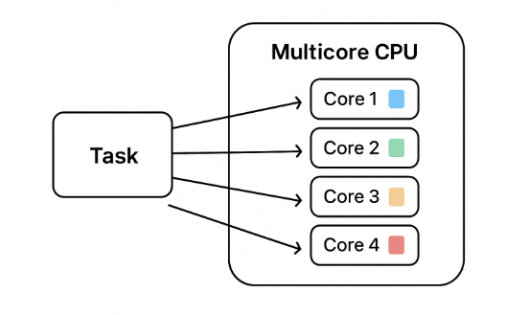
MULTICORE PROGRAMMING
A multicore processor contains two or more processing cores on a single chip.
Each core can execute instructions independently, enabling parallel execution.

Slide 8

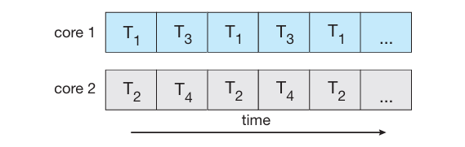
Concurrent execution on a single-core system.
Parallel execution on a multicore system.

Slide 9
User-Level Threads (ULT) | Kernel-Level Threads (KLT)
User-level thread library (e.g., POSIX pthread, Java threads) | Operating System kernel
Runs in user space | Runs in kernel space
No kernel mode switch → faster | Requires kernel mode switch → slower
Done by user thread library (OS not aware) | Done by OS scheduler
If one thread blocks, entire process blocks | If one thread blocks, others keep running
Low (no kernel involvement) | High (kernel involvement)
Highly portable (works across OSs) | Less portable (depends on OS)
Cannot run truly in parallel (only one thread executes at a time per process) | Can run truly in parallel on multiple processors
Java green threads, early Python threads | Windows threads, Linux pthread (modern)

Slide 10
Multithreading models
In Operating Systems, multithreading models define how user threads are mapped to kernel threads.
Multithreading model are of three types.
Many to many model.
Many to one model.
One to one model.

Slide 11
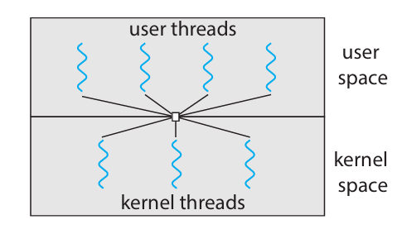
Many to many model
Have multiple user threads multiplex to same or lesser number of kernel level threads.
If a user thread is blocked, we can schedule others user thread to other kernel thread.
System doesn't block if a particular thread is blocked.
It is the best multi threading model.

Slide 12
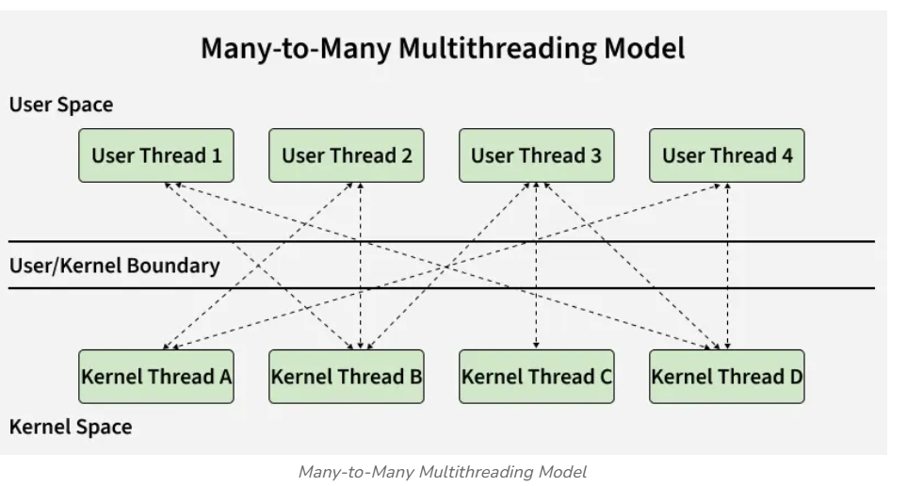

Slide 13
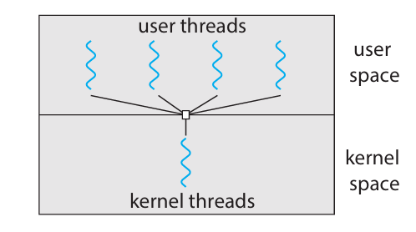
Many to one model
Have multiple user threads mapped to one kernel thread.
A user thread makes a blocking system call entire process blocks.
Have only one kernel thread and only one user thread can access kernel at a time, so multiple threads are not able access multiprocessor at the same time.

Slide 14
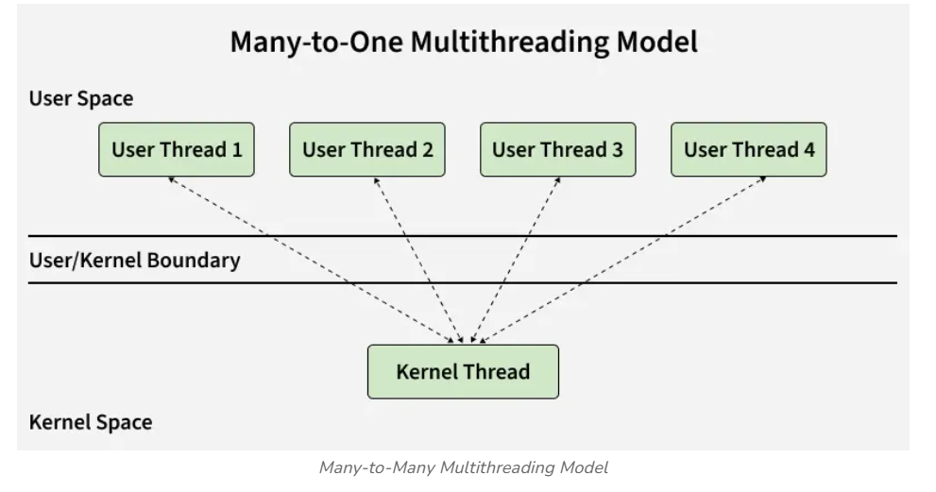

Slide 15
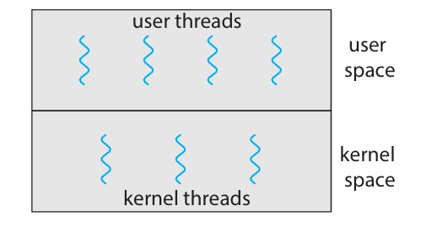
one to one model
One to one relationship between kernel and user thread.
In this model multiple thread can run on multiple processor.
Problem with this model is that creating a user thread requires the corresponding kernel thread.
As each user thread is connected to different kernel , if any user thread makes a blocking system call, the other user threads won't be blocked.

Slide 16
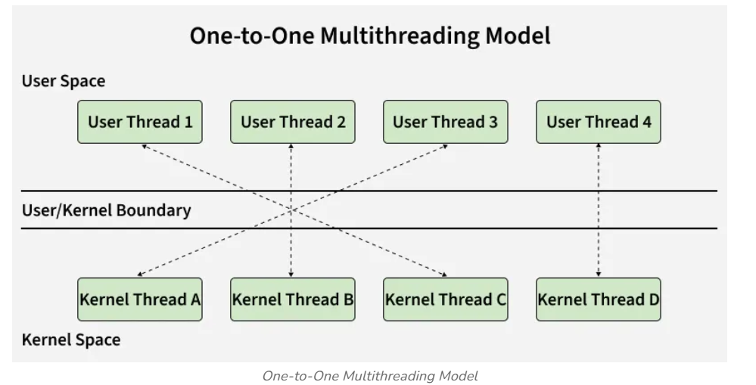

Slide 17
Thread Applications
Web Servers
Word Processors
File Download Managers
Multimedia Applications
Online Games
Web Browsers
Database Servers
Real-Time Systems
Network Servers
Operating System Kernels

Slide 18
Common Threading Issues
1. Race Condition | Occurs when two or more threads access shared data simultaneously, and the final result depends on the order of execution.
2. Deadlock | Two or more threads wait indefinitely for each other to release resources.
3. Starvation | A thread never gets CPU time or resources because other threads keep occupying them.
4. Livelock | Threads keep responding to each other’s actions but never make progress.
5. Priority Inversion | A lower-priority thread holds a lock needed by a higher-priority thread, causing the high-priority thread to wait.

Slide 19
Thank you!
Gratitude turns ordinary moments into blessings!

